Slide 1
TEXT MINING - MAHABHARATA
Aleksander Michoński & Balaganesh Mohan

Slide 2
DATASET
Text file downloaded from gutenberg.org
It narrates the struggle between two groups of cousins in the Kurukshetra War
Roughly 10 times the size of iliad and odyssey combined ,
Originally written in sanskrit, translated to English in modern times.

Slide 3
NLTK
Number of unique words | 32,517
Number of sentences | 1,18,087
Number of volumes | 18
Number of characters appearing more than 10 times | 210
SPACY

Slide 4
Questions
WHO ARE THE PROTAGONISTS?
HOW ARE THEY VIEWED IN THE LITERATURE?
WHERE DID THEIR TRAVELS TAKE THEM?

Slide 5
Text pre processing with SPACY
Split the full volume book into different chapters (18)
Tokenization - word
Stop words
stemming
POS Tagging
NER Tagging
Character count:
Find the most mentioned character and how they are described with their adjectives tags. Problem! How to include aliases?
Adjectives:
Entity (e1) = (NP (DT the) (ADJP (RB highly) (JJ intelligent) (CC and) (JJ high-souled)) (NNP Krishna)) = [the highly intelligent and high-souled Krishna] Entity
(e2) = (NP (NNP Krishna)) = [Krishna]

Slide 6
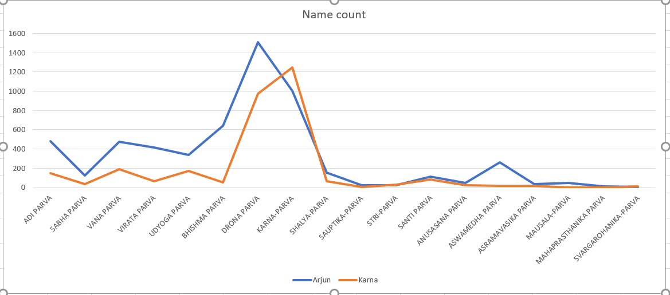

Slide 7
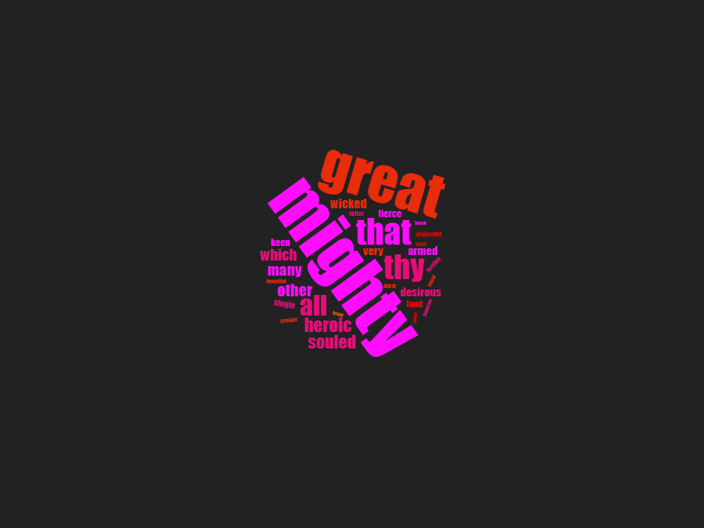
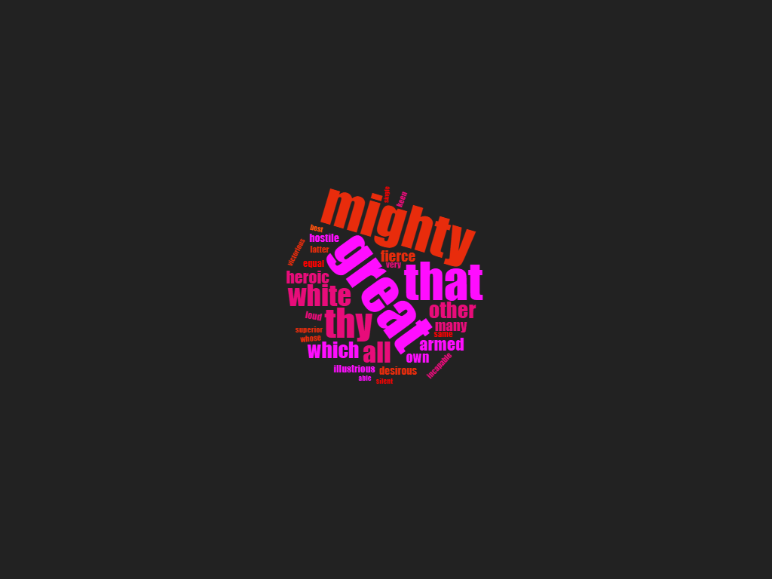
ADJECTIVES
Karna
Arjuna

Slide 8
Sentiment Analysis
Split documents into 18 volumes.
Sentence tokenizing.
VADER framework built over NLTK which can get sentiment scores on word and sentence level.
Get compound scores of sentiments per sentence.
Weighted average of each volume and visualizing.

Slide 9
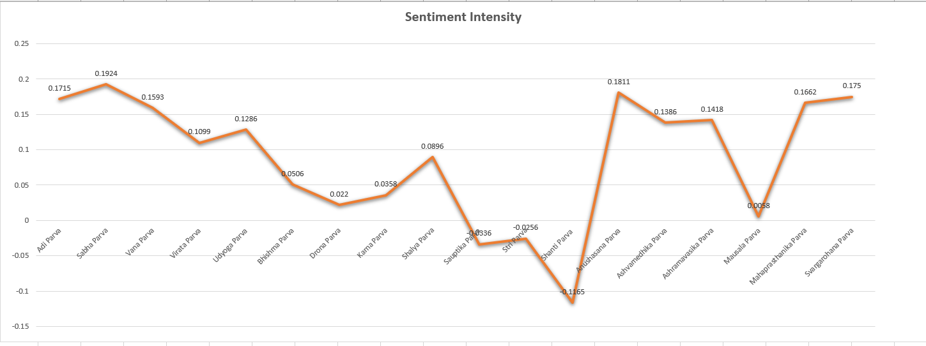
1.0 being highest positive score and -1.0 being lowest negative score.

Slide 10
Video map of Arjuna’s wanderings

Slide 11
Relationship/similarity extraction
Training word2vec and build a vocabulary.
The trained vectors will be in high dimensions.
Using t-distributed stochastic neighbor embedding or t-SNE or PCA to reduce this higher dimension to a feasible, analyzable dimension size.

Slide 12
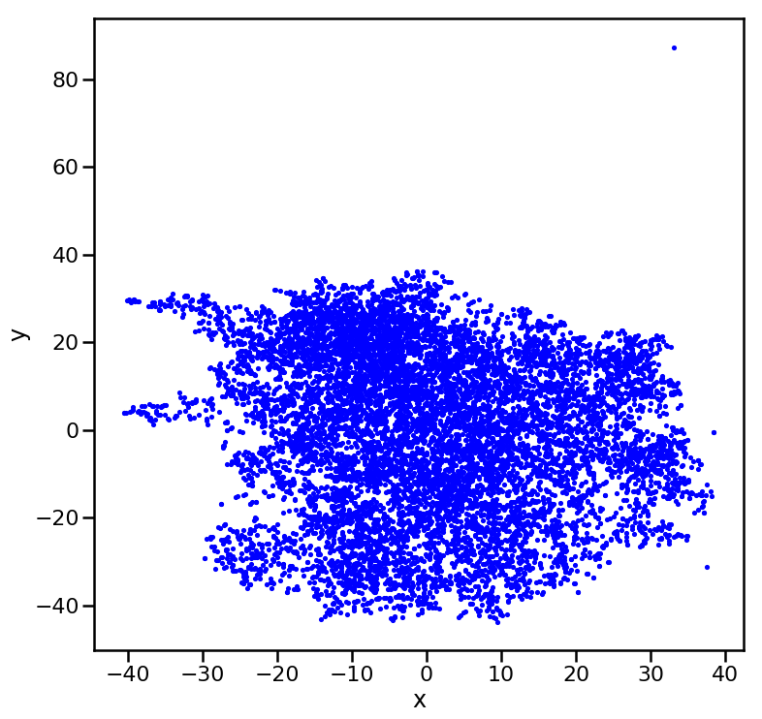
T-sne scatter plot for full corpus.

Slide 13
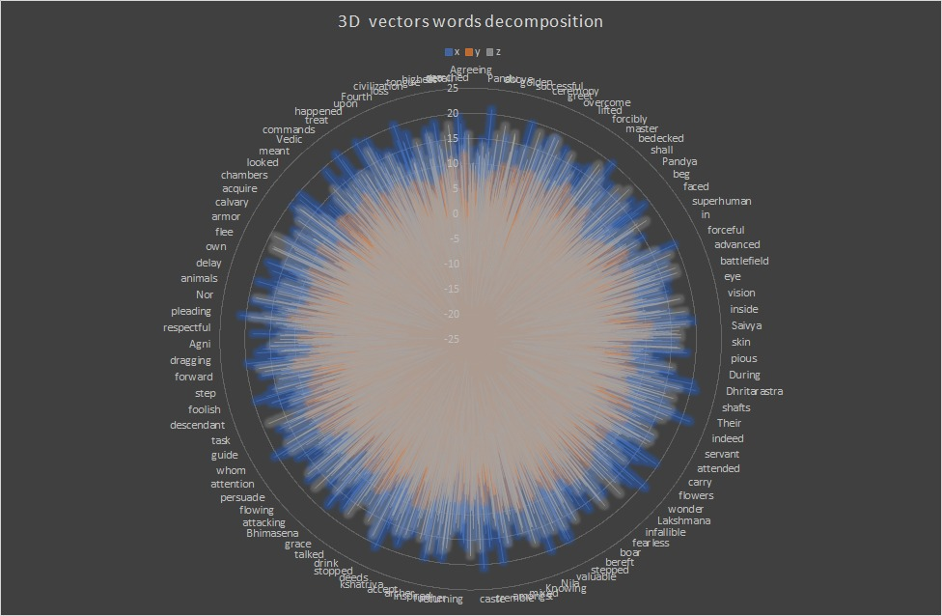

Slide 14
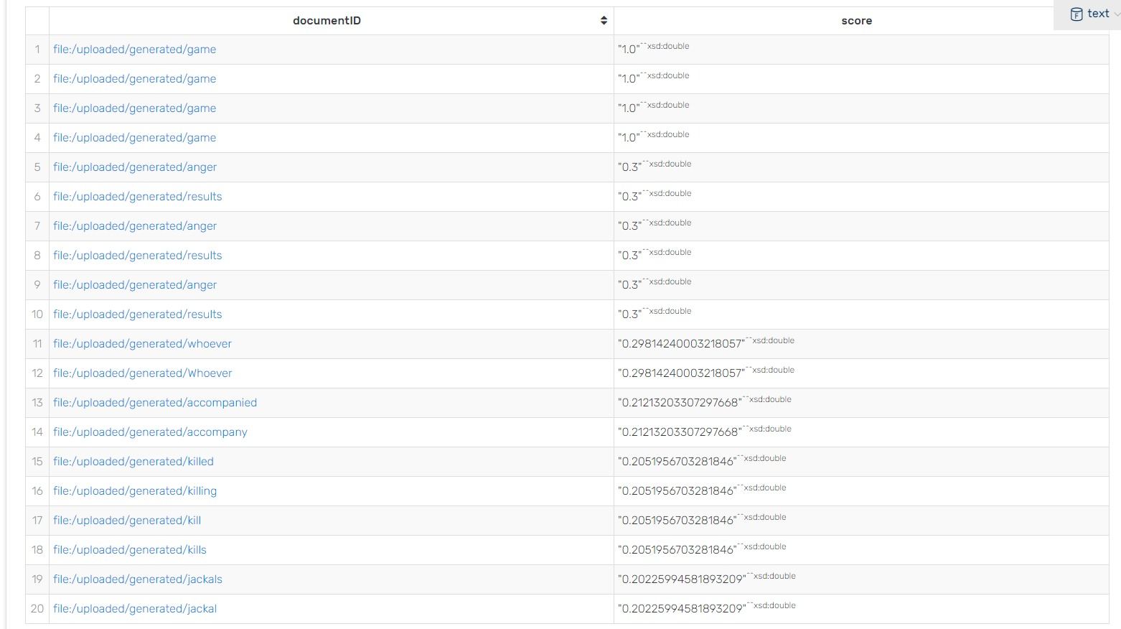
Index similarity

Slide 15
FUTURE WORK
Word2vec on linguistic data is not the best approach, so we have to explore more modern approaches
Try the same word embeddings with deep learning methods applying elmo/bert for better results and accuracy.
Try to implement social network based on family relationship.

